Slide 1
DevOps Lifecycle

Slide 2
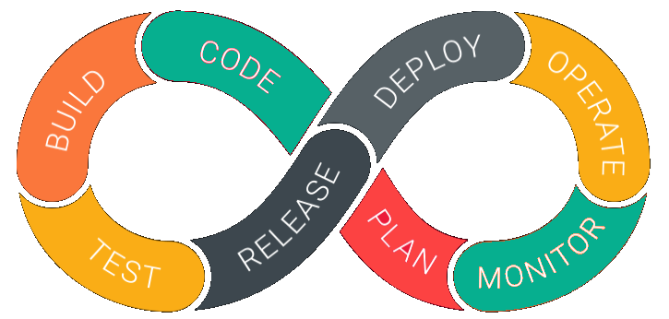
DevOps Lifecycle
DevOps is deep integration between development and operations. Understanding DevOps is not possible without knowing DevOps lifecycle.

Slide 3
DevOps life-cycle
1. Development
In this DevOps stage the development of software takes place constantly. In this phase, the entire development process is separated into small development cycles. This benefits DevOps team to speed up software development and delivery process.
2. Testing
QA team use tools like Selenium to identify and fix bugs in the new piece of code.

Slide 4
DevOps life-cycle
3. Integration
In this stage, new functionality is integrated with the prevailing code, and testing takes place. Continuous development is only possible due to continuous integration and testing.
4. Deployment
In this phase, the deployment process takes place continuously. It is performed in such a manner that any changes made any time in the code, should not affect the functioning of high traffic website.

Slide 5
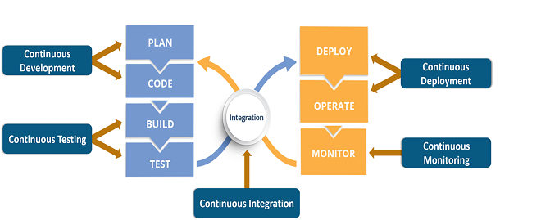
DevOps life-cycle
5. Monitoring
In this phase, operation team will take care of the inappropriate system behavior or bugs which are found in production.

Slide 6
What are the core operations of DevOps with application development and with infrastructure?
development
Code building
Code coverage
Unit testing
Packaging
Deployment Application
Infrastructure Development
Provisioning
Configuration
Orchestration
Deployment

Slide 7
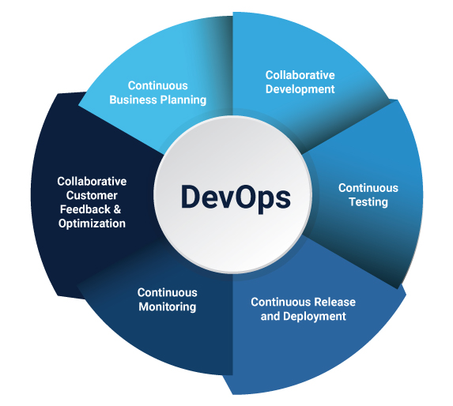
Decoding the DevOps Lifecycle
DevOps is primarily implemented in application development for e-commerce websites, cloud-native applications, and other large distributed platforms. It consists of multiple phases that collectively become the DevOps lifecycle.
Continuous Development
Continuous Integration
Continuous Testing
Continuous Feedback
Continuous Monitoring
Continuous Deployment
Continuous Operations

Slide 8
1. Continuous Development
The first phase of the DevOps lifecycle is where the planning and software coding takes place. The planning involves understanding the vision of the project and envisioning a software based on those perceptions.
Planning doesn’t involve any major tools, but maintaining the code entails the use of a range of tools. Developing the source code for application begins by choosing from the different programming languages. JavaScript, C/C++, Ruby, and Python are prominently used for coding applications in DevOps.

Slide 9
1. Continuous Development
The process of maintaining the code is called Source Code Management (SCM), where version control tools such as GIT, TFS, GitLab, Subversion, and Mercurial, among others, are used.
In the SCM process, GIT is a preferred tool that enables a distributed version control. It facilitates data assurance through circulated non-linear workflows. For large projects, where a vast number of collaborators are involved in the development activity, GIT establishes reliable communication between the teams through the Commit messages.

Slide 10
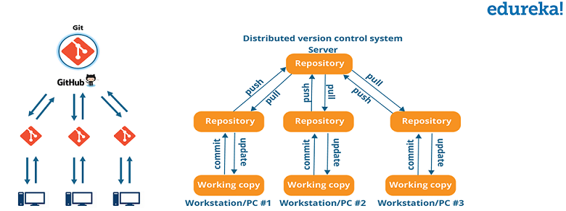
1. Continuous Development
With the help of a version control tool, a stable version of the application code is built in the continuous development phase. Developers can also package the code into .exe (executable) files by using Garden, Maven, and similar tools.

Slide 11
1. Continuous Development
This is the phase that involves ‘planning‘ and ‘coding‘ of the software. The vision of the project is decided during the planning phase and the developers begin developing the code for the application. There are no DevOps tools that are required for planning, but there are a number of tools for maintaining the code.
The code can be written in any language, but it is maintained by using Version Control tools. Maintaining the code is referred to as Source Code Management. The most popular tools used are Git, SVN, Mercurial, CVS, and JIRA. Also tools like Ant, Maven, Gradle can be used in this phase for building/ packaging the code into an executable file that can be forwarded to any of the next phases.

Slide 12
Now let us try to know a bit more about Git.
Git is a distributed version control tool that supports distributed non-linear workflows by providing data assurance for developing quality software. Tools like Git enable communication between the development and the operations team.
When you are developing a large project with a huge number of collaborators, it is very important to have communication between the collaborators while making changes in the project.
Commit messages in Git play a very important role in communicating among the team. Apart from communication, the most important reason to use Git is that you always have a stable version of the code with you.
Hence, Git plays a vital role in succeeding at DevOps.

